Slide 1
How influential are music critics?
Gradon Nicholls
Oct 25, 2021

Slide 2
Motivation
Economics: consumer demand
How does positive or negative reviews impact consumer demand for music?
Non-linearity? Both negative and positive reviews drive increased sales?
Does this differ for big name artists vs. smaller artists?
Does “new media” have more of an impact than “old media”
How correlated are customer reviews and critic reviews?
Idea: regress number of listens of an album on critic scores

Slide 3
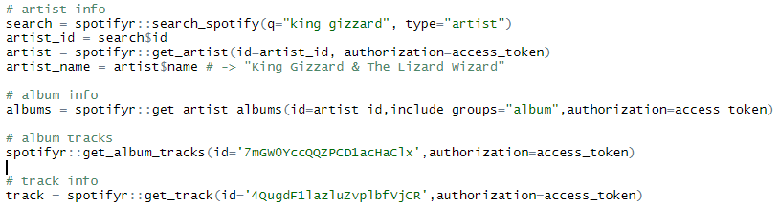
Data I - Spotify
R package: spotifyr for spotify api
Data on release date, explicit content, music theory

Slide 4
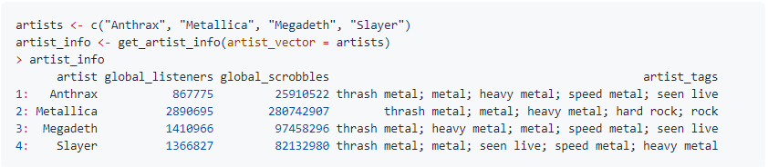
Data II – Last.FM
Spotify does NOT have number of listens!
Rely on a proxy using Last.fm “scrobbles”
GitHub - ppatrzyk/lastfmR: R package for getting last.fm data
(example code taken from github readme)

Slide 5

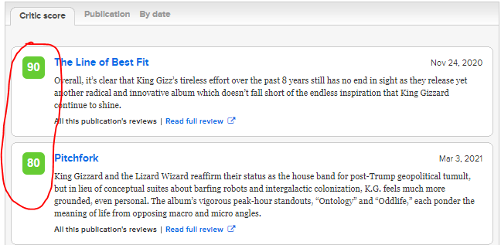
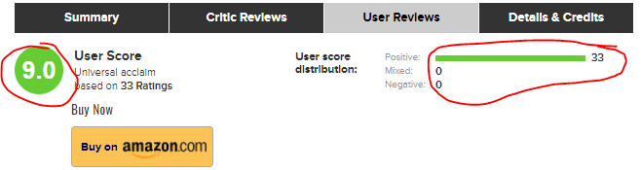
Data III – Metacritic

Slide 6
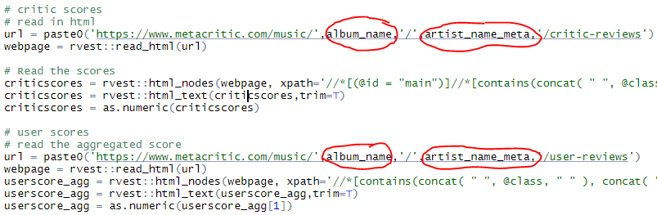
Data III – Metacritic

Slide 7
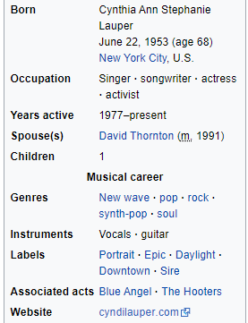
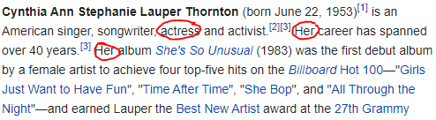
Data IV – Wikipedia -> demographics

Slide 8
Merging data
Start with list of artist names
For each name, use spotifyr to find official artist name (if differs from list) and spotify statistics
Use official artist name to merge with
Last.fm
Metacritic
Wikipedia

Slide 9
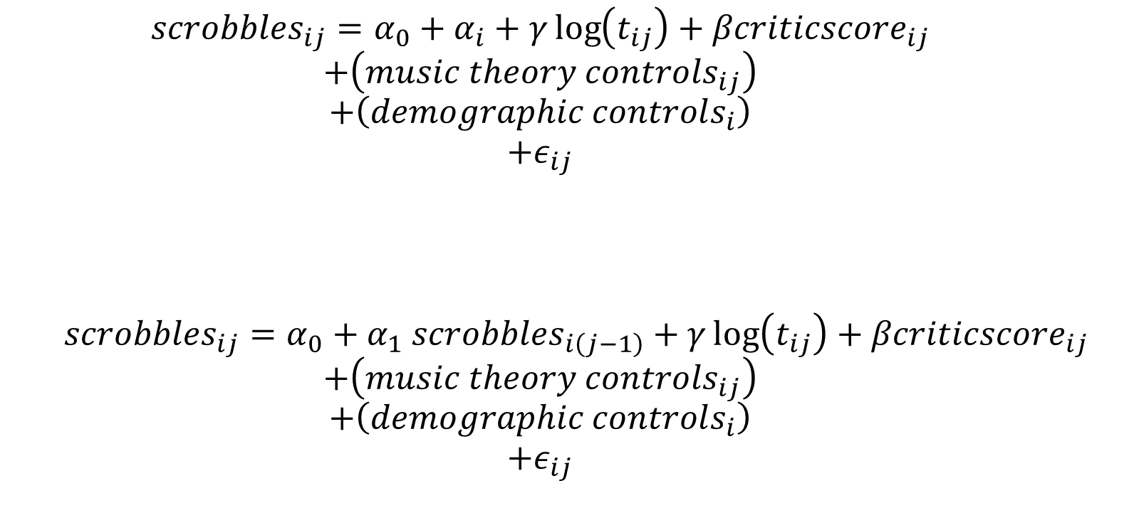
Model
Artist fixed effect
How long album has been out
Metacritic scores
$$scrobbles_{ij}=α_{0}+α_{i}+γ\log\left(t_{ij}\right)+βcriticscore_{ij}$$
$$+\left(music theory controls_{ij}\right)$$
$$+\left(demographic controls_{i}\right)$$
$$+ε_{ij}$$
$$scrobbles_{ij}=α_{0}+α_{1} scrobbles_{i\left(j−1\right)}+γ\log\left(t_{ij}\right)+βcriticscore_{ij}$$
$$+\left(music theory controls_{ij}\right)$$
$$+\left(demographic controls_{i}\right)$$
$$+ε_{ij}$$
From spotify
From wikipedia
Capture correlation across albums from same artist

